Slide 1
RFC pqc Key Identification and Serialization public
Christine van Vredendaal (NXP)
Joint work with: Dieter Bong (Utimaco), Joppe Bos (NXP) Silvio Dragone (IBM), Basil Hess (IBM), Christopher Meyer (Utimaco), Mike Osborne (IBM), Karen Willbrand (Utimaco)
june 2021

Slide 2



Pre-quantum world
RSA/ECC Key exchange
“Let’s use NIST P-256 (secp256r1)”
Alice
Bob

Slide 3



Post Quantum world
RSA/ECC Key exchange
“Let’s use NIST P-256 (secp256r1)”
Alice
Bob

Slide 4

Post-Quantum world
PQC Key exchange
“Let’s use KyberKEM-768”
Alice
Bob

Slide 5

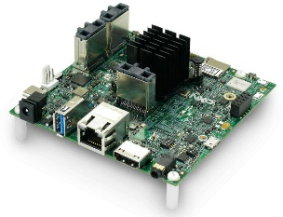
Pre-quantum world
RSA/ECC Key exchange
“Let’s use NIST P-256 (secp256r1), here’s a key”
Alice
Bob
{1 byte}
{32 bytes}
{32 bytes}
04
7132b0b1255f ….. abcdef1337
4961ee7e7a1 ….. 9d9bada551
or
{1 byte}
{32 bytes}
03
14916253649 ….. 42deadb33f

Slide 6

Post-Quantum world
“Let’s use KyberKEM-768, here is a key”
PQC Key exchange
“Let’s use KyberKEM-768, here is a 90s version key and I assume the round 2 structuring”
Alice
Bob

Slide 7
PQC Key serialization and identification
To ensure correct communication key formats are serialized.
PQC key formats are unspecified, yet
Different versions: Round 1, 2, 3, standardized
Different compression choices
Higher level (than crypto API) considerations:
How to store / load the key from key formats (ordering)
Optional choices (for performance / size considerations)
Hybrid modes?
Popular submissions are being deployed in practice NOW (positive!) →interoperability gets challenging
Solving this now will avoid larger problems in the future

Slide 8
Solution direction
We cannot solve the world, but we can take first step in the right direction
An RFC specifying key formats will help
Help manage algorithm versions and compatibility in key formats
Help interoperability of both testing and integration
Help make choices in future standards clear
Help prevent delays in integration and adoption
Draft RFC “PQC Key Identification and Serialization” is shared with the cryptographic community

Slide 9
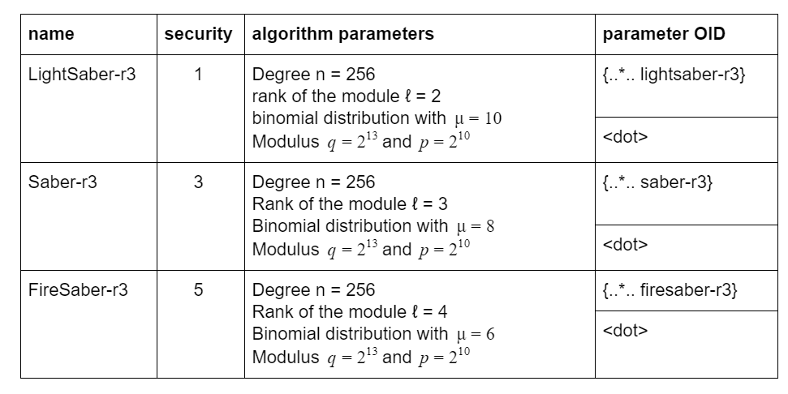
In the RFC: parameter identifiers
Describe parameter choices of parameter sets
For now, includes Round 3 finalist sets
OIDs to be filled in

Slide 10
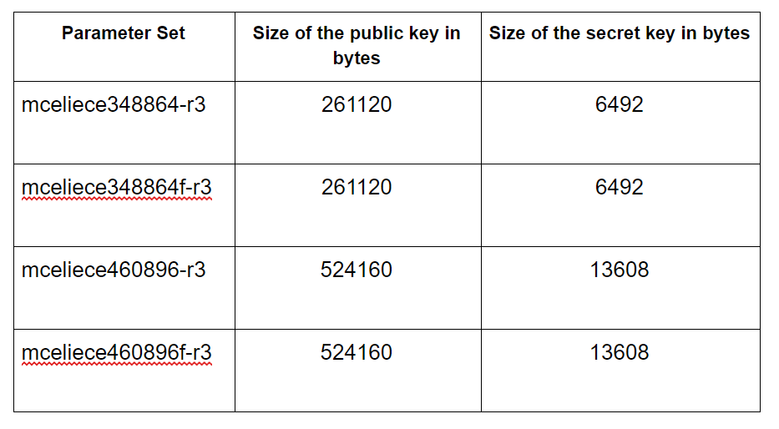
In the RFC: key descriptions and sizes
For each parameters sets, descriptions of the various components key and their sizes
Byte sizes of the full keys
Different compression options, like e.g. Rainbow has, are also included

Slide 11
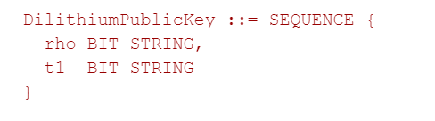
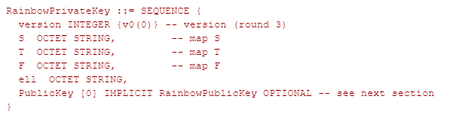
In the RFC: ASN.1 formats
Indicates the version and order of the parameters
Optional fields for public keys / optional algorithm parameters
BIT/OCTET choice currently on what seemed logical from the specs

Slide 12

What’s next?
Post draft as IETF RFC
Align with NIST on algorithm OIDs
Align with ETSI / OASIS SAM / PKCS11 / KMIP TC / more
Resolve issues around hybrid modes (IP, key serialization)
Encouraged format for migration
Path is uncertain
Alternate Round 3 candidates
Interested in keeping updated? Or contributing as a reviewer?
Contact us through: pqc@nxp.com

